Slide 1
Vector tools I used
I will explain the stages and tools I used to create my logo

Slide 2
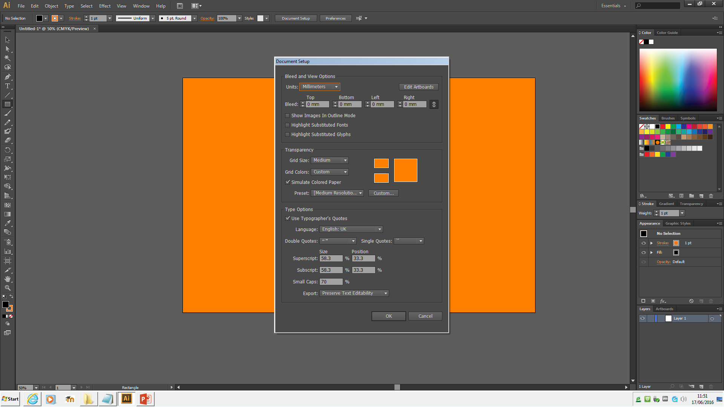
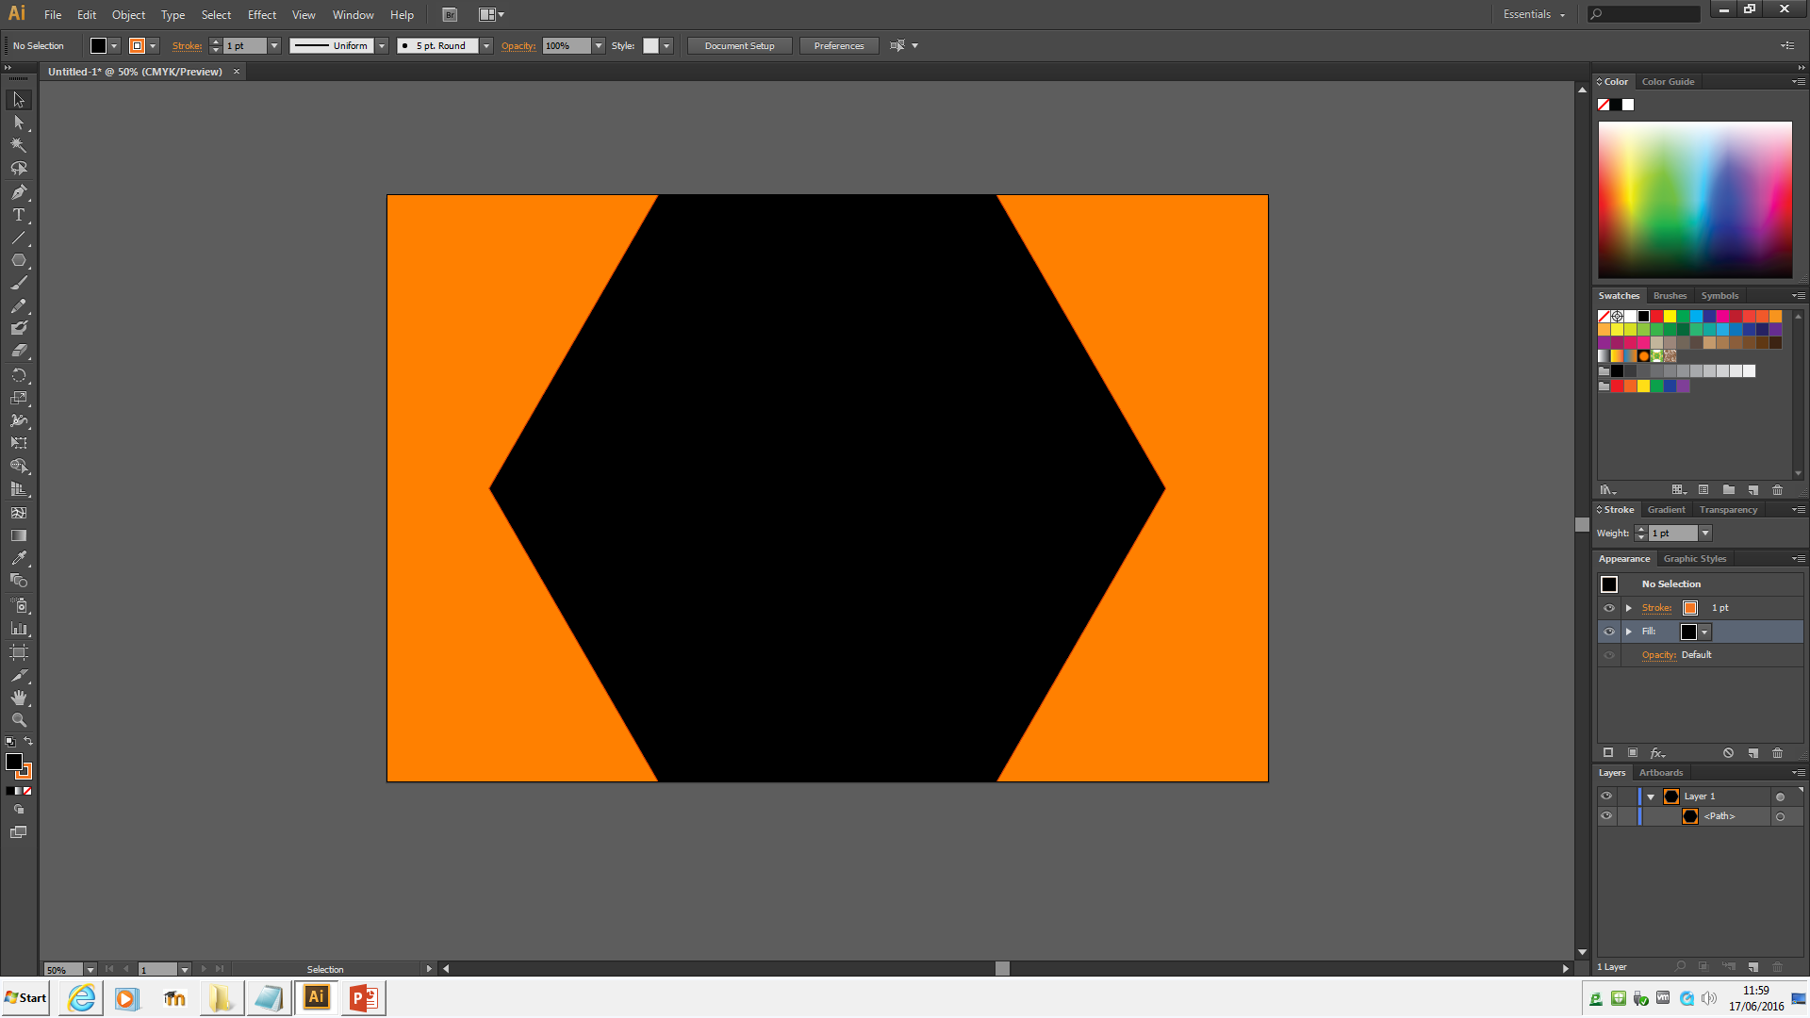
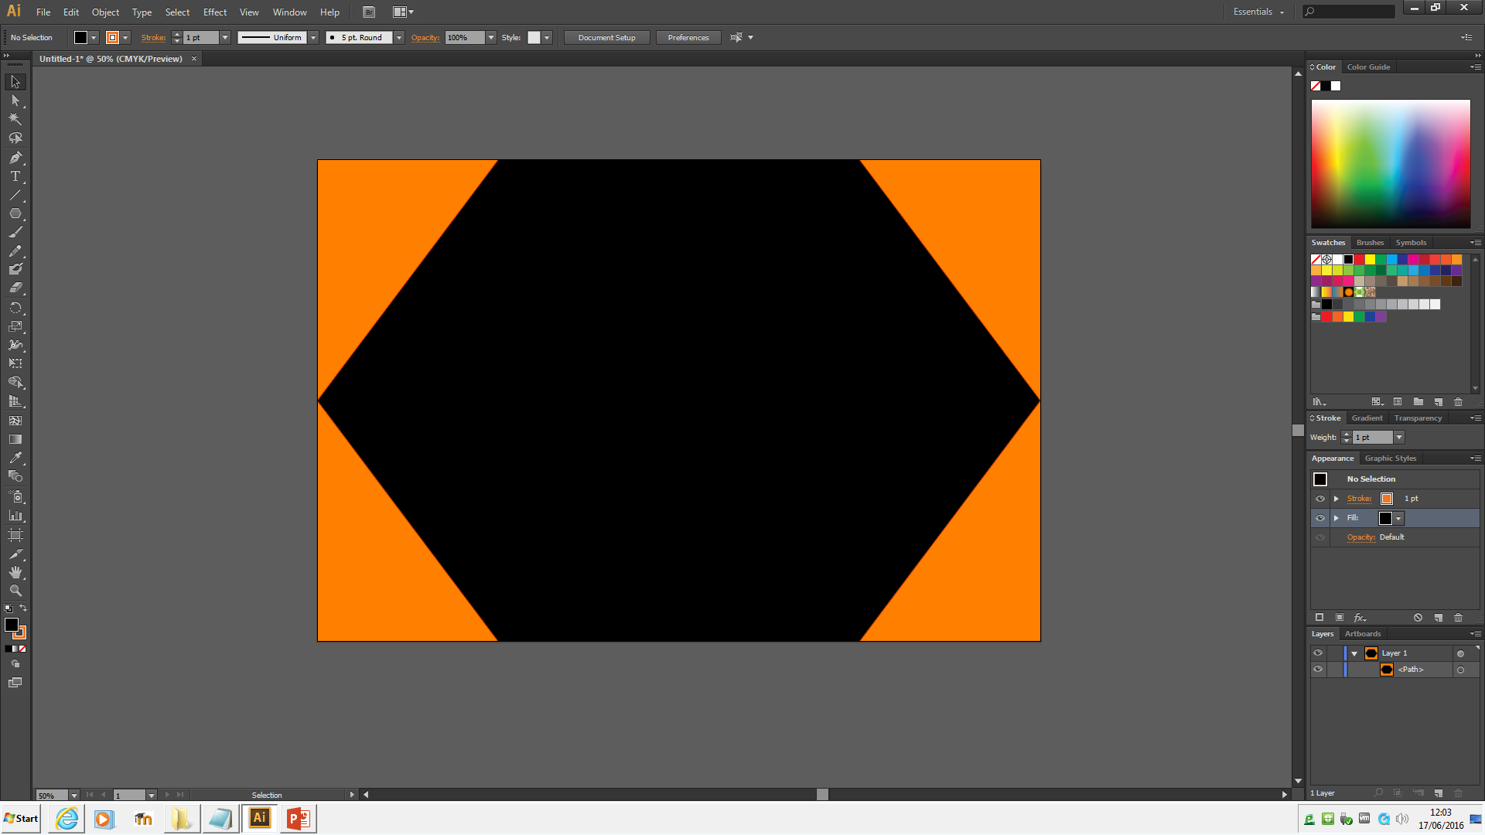

i started my logo mock up by creating a 660x440 mm page, following the idea I had
for my logo I then went into the document setup and changed the background colour to
be orange.
With the background created I went to the rectangle tool and I changed it to a polygon
Tool so I could create a polygon in the centre of my page.
With this created a decided that it would look better if the points were touching the edged of the background to I decided to use the scale tool to move the two points. To do this I anchored down the other points so they wouldn’t move and I then dragged each corner of the pentagon to the side and anchored each one once they was in place.

Slide 3
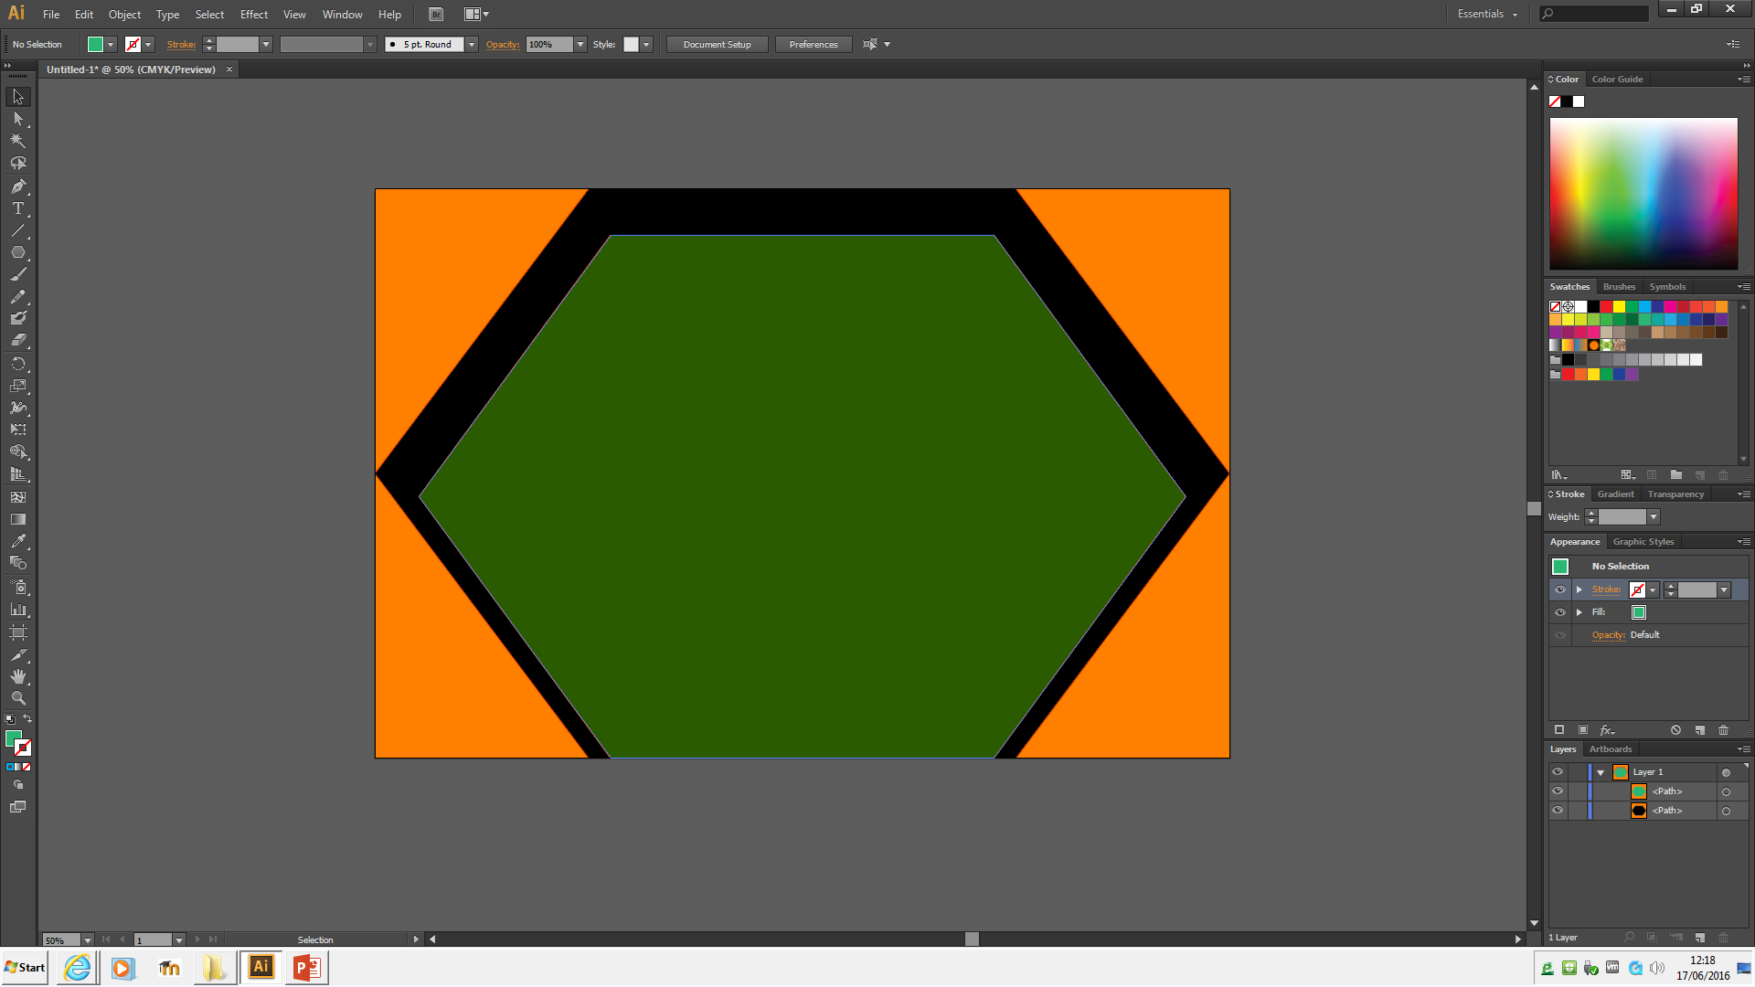
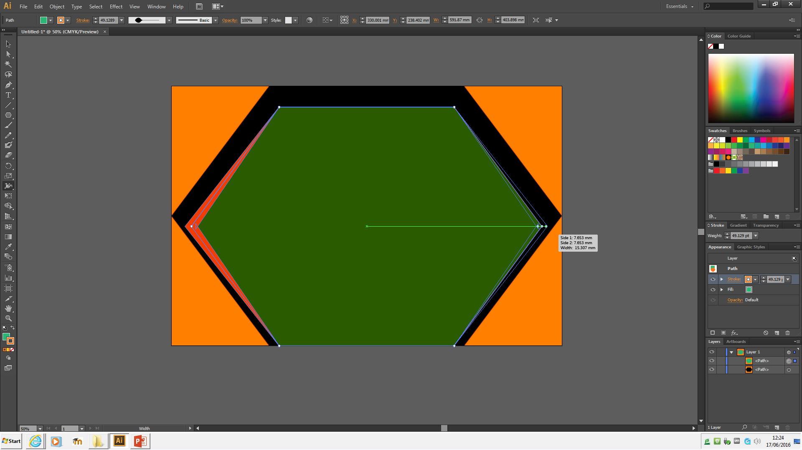
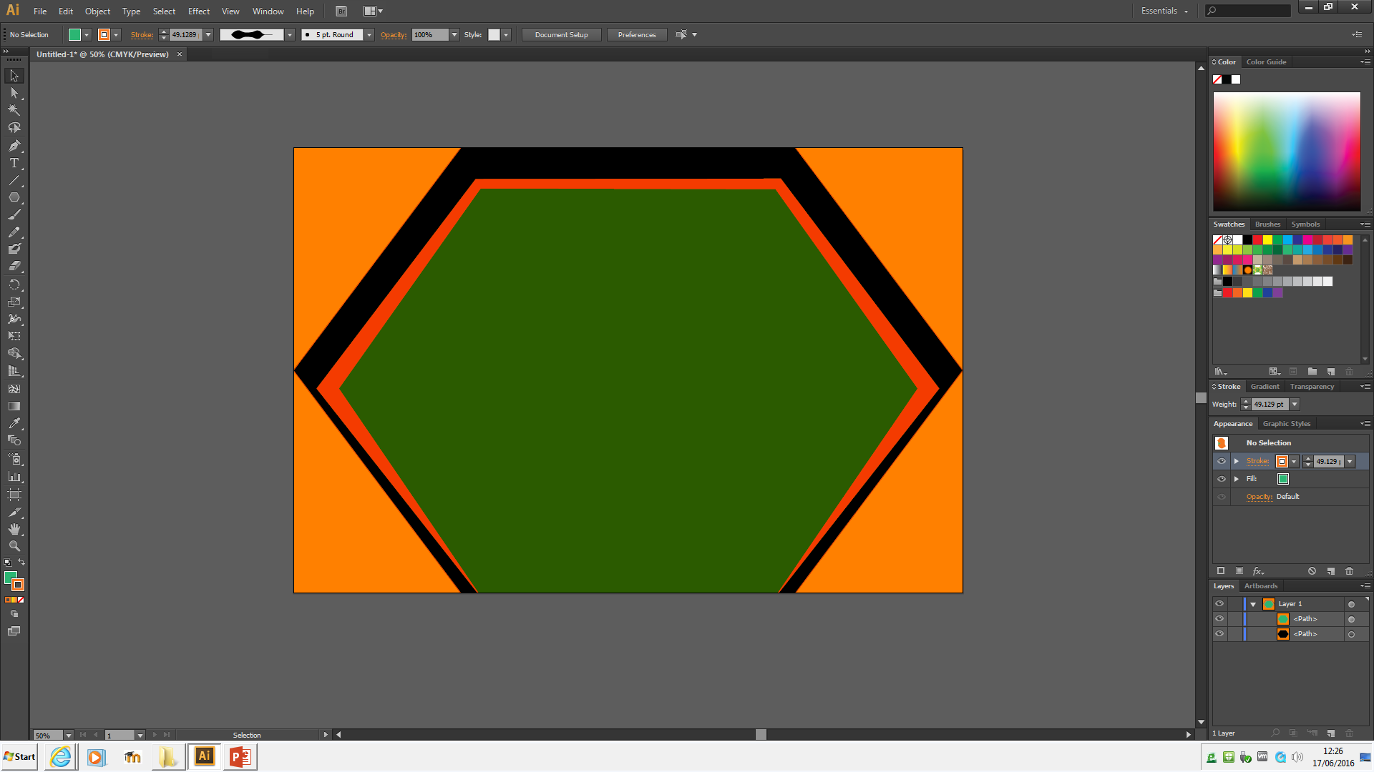
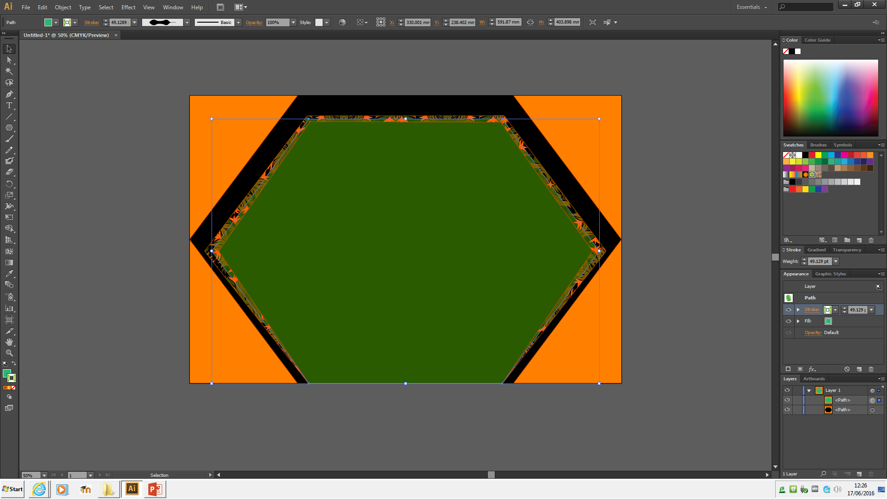
With the background shape in place I decided to copy and paste it and to use it to use it to go in front of the first pentagon, I did this so that I could have each a different colour and have multiple colours in the logo. I shrunk the second pentagon so it wouldn’t completely cover up the first.
I changed the colour of the second pentagon to green so it would
Stand out more
I then used the width tool to increase the size of the width on the
Outside of the pentagon.
I then changed the appearance of the width.

Slide 4
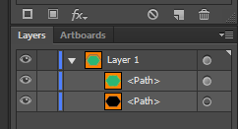

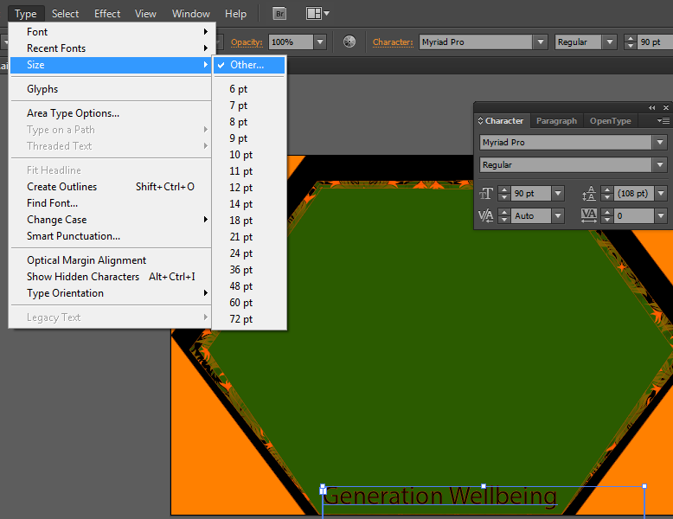
with the background completed I decided it would be best to lock the layers for them so they wouldn’t move when I was editing other layers.
With the layers unable to move I decided to add in some text to my logo to
that is relevant to the websites, I then used type section to change the font
size and change the colour.
With the text and background set I decided to create the stick figures which
Were on my original logo design.

Slide 5
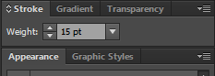
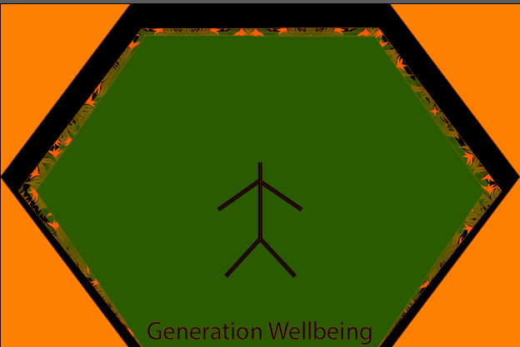
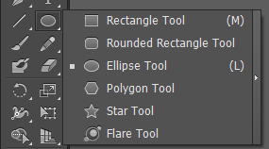
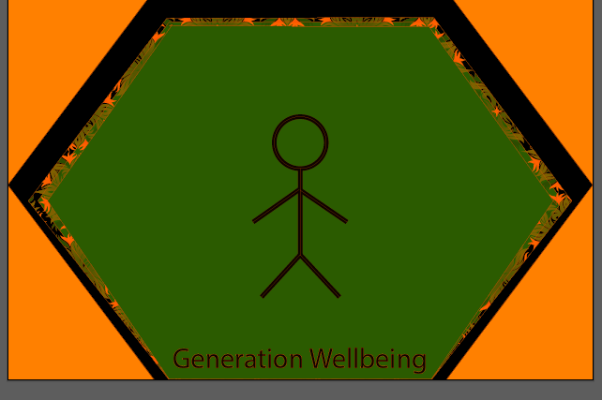
I started creating my stick figure by using line segment tool to create a line that would be its body.
once I had created this line I noticed that it was very small and unnoticeable so I decided to increase the weight of the stroke from 1pt to 15pt.
Once I had created the line as thick as I want I did this for each arm and leg
Until everything but the head was complete.
I then used the ellipse tool to create a circle for the head of the stick man

Slide 6
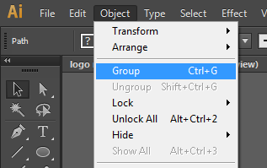
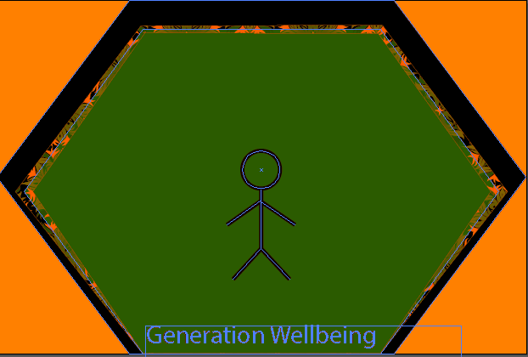
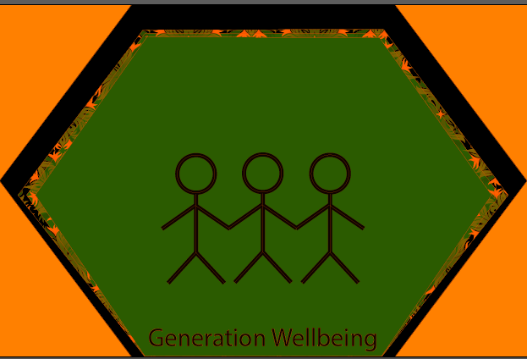
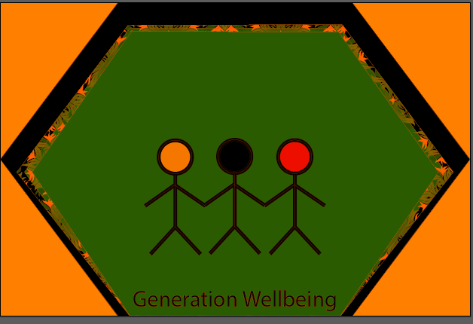
With the first stick man completed I decided that instead of having lots of multiple objects and layers It would be best to create them as a group so they would be easier to use and manipulate.
Following my original logo design I used the first stick figure to create a few more, I
Did this by copying and pasting the first stick man to create one at either side of
The original one.
Once I had all of the stick figures in place I decided that it would be better to make each one unique by filling in the head of each one with a different colour.

Slide 7
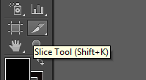
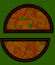
The last part of my logo was to create the heart behind the stick man to emphasise health, although this proved to be a too difficult shape to create with the tools in adobe illustrator so instead I decided to just add in a shape behind them instead.
I started by creating a perfectly even circle by holding shape and dragging the shape out.
with this basic circle I decided to use the knife tool to cut the circle in half to create a semi circle.
With the semi circle I then increased the size and placed it behind the stick figures.

Slide 8
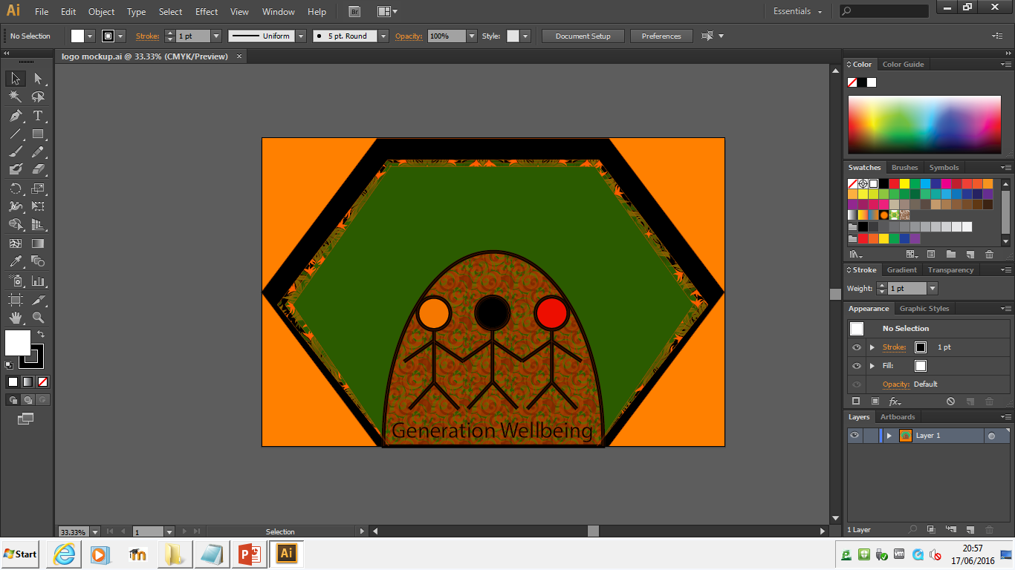
The logo below is my finished mock up of the logo and although it isn’t all that appealing it followed my original logo design and was used in a vector editing software which allowed me to use a bunch of different vector tools to attempt to create something good.

